Slide 1
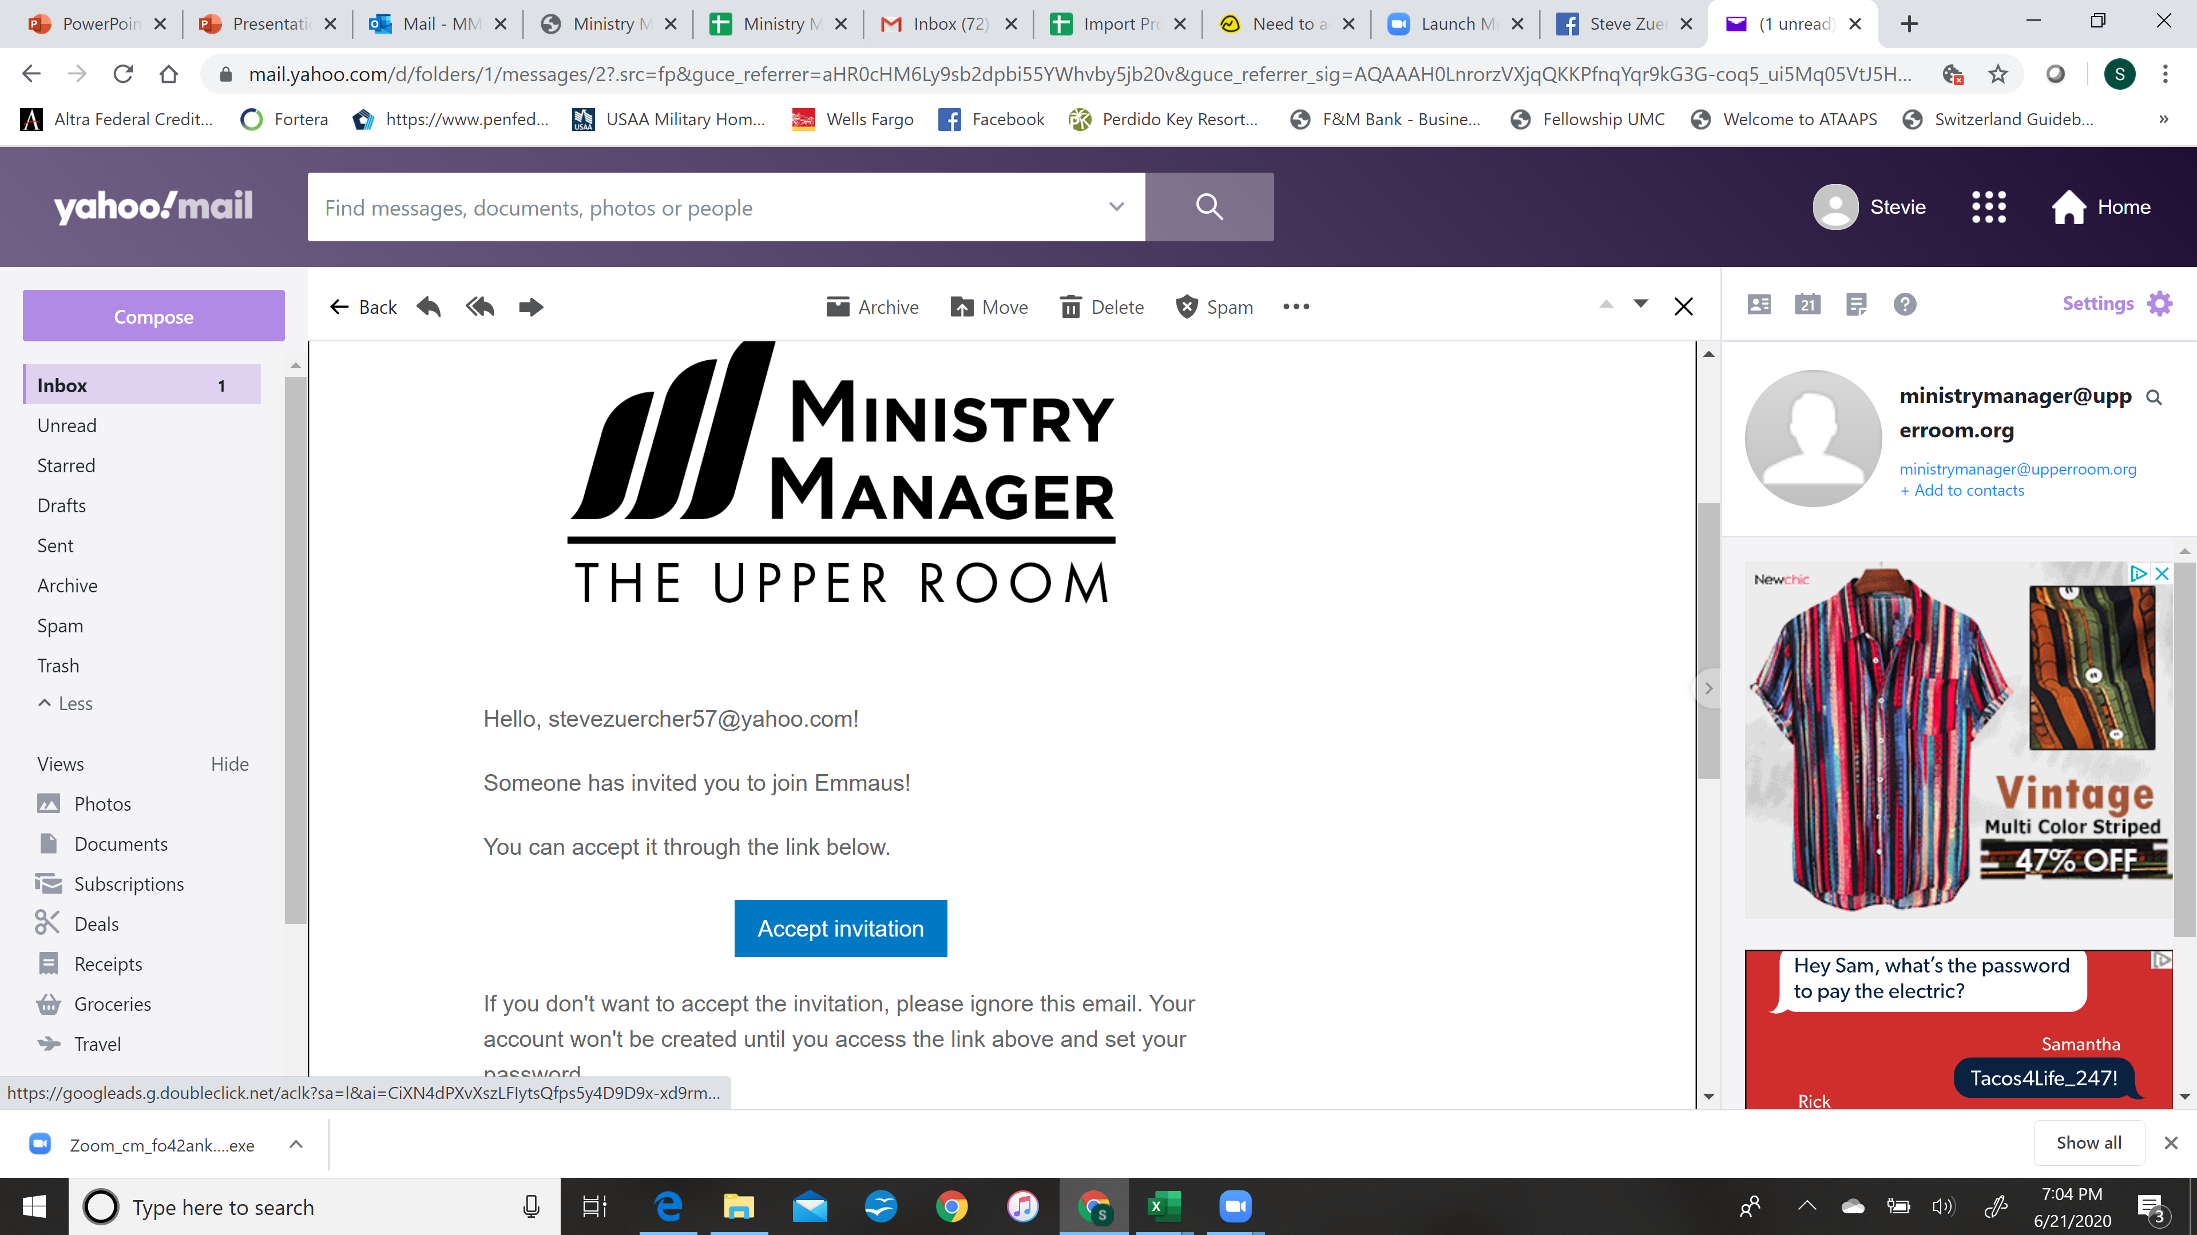

Slide 2
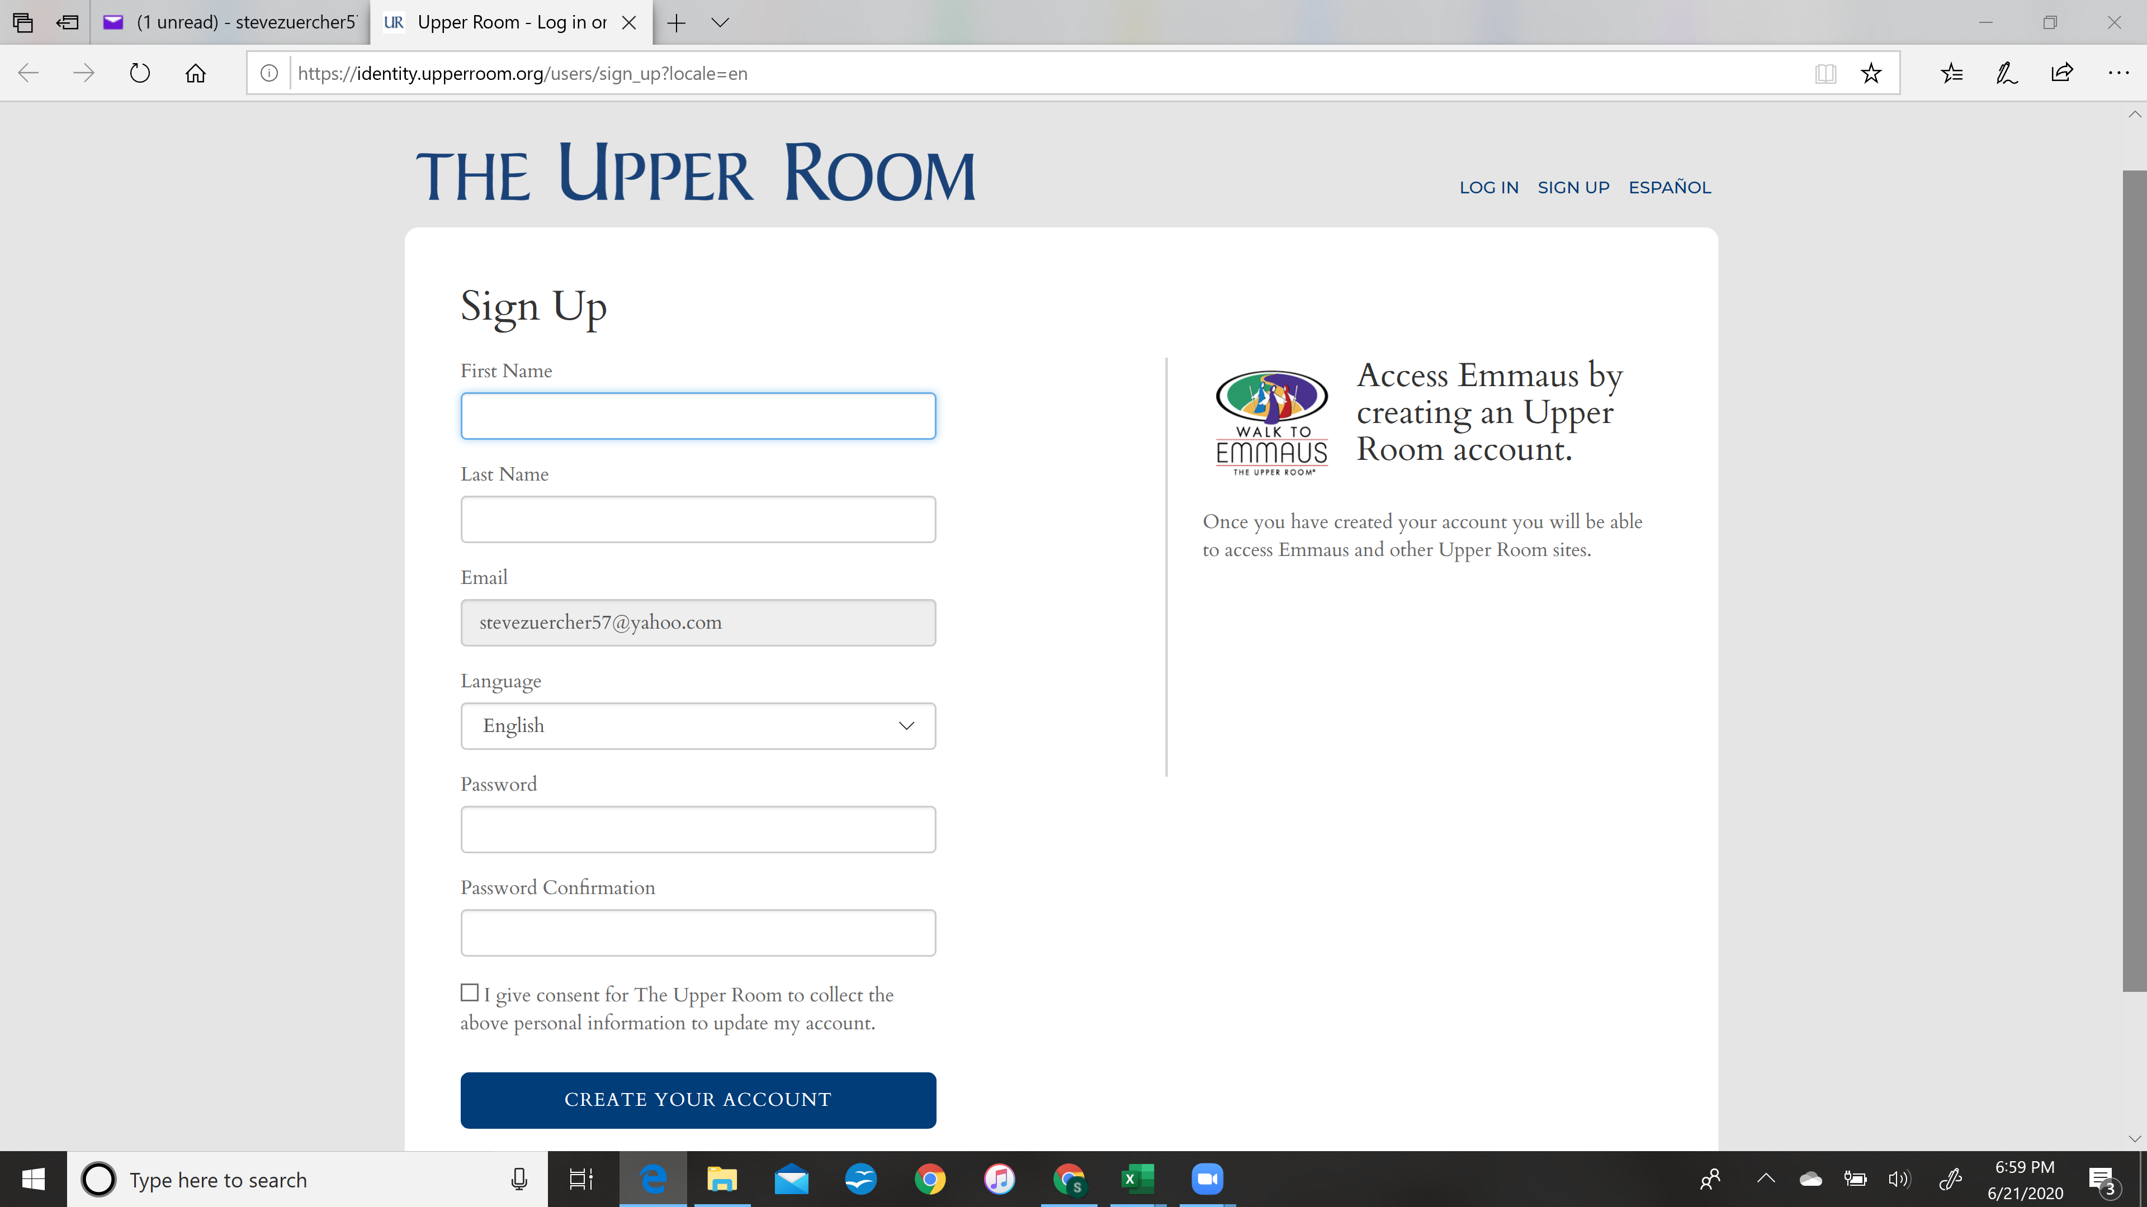
Enter F_name, L_name
Enter password and confirm
Click consent box

Slide 3
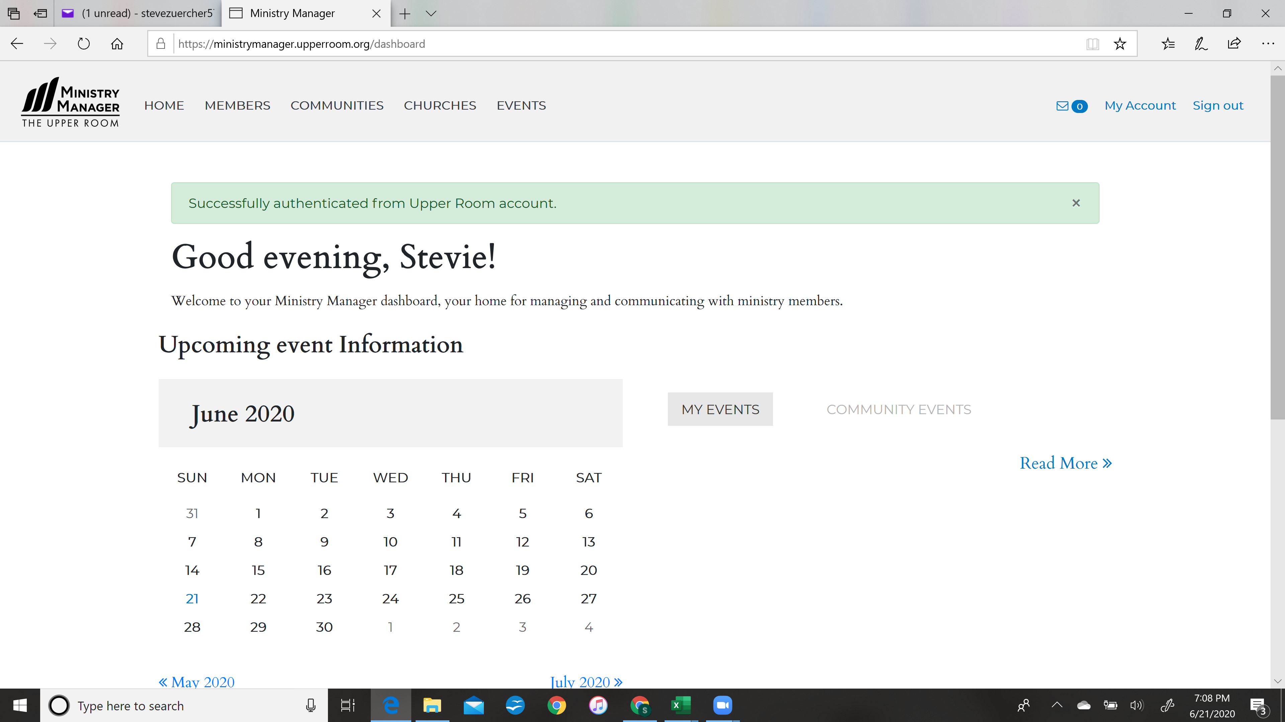

Slide 4
